Slide 1
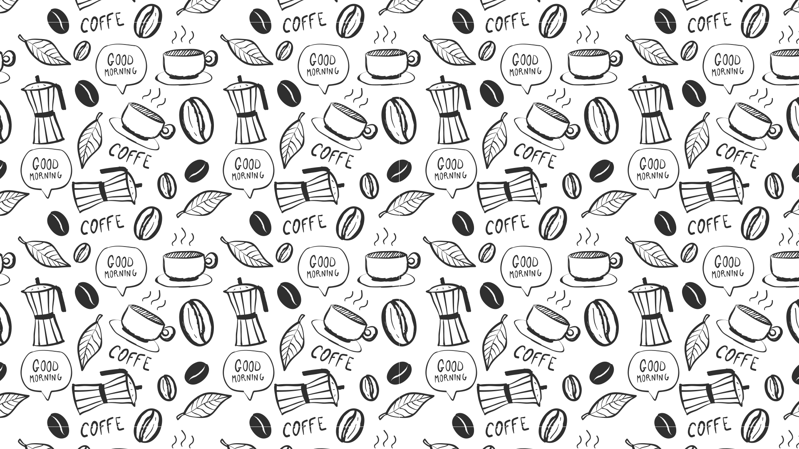

Slide 1
Find the best location for new Coffee Shop in Riyadh
Applied Data Science Capstone
Eman Al-Regaai

Slide 2


Slide 2
Introduction
Business owner can change anything after he open his business but not the location, so we have to help our client choose the right location for his new Coffee Shop

Slide 3
Slide 3
Business Challenge
what we want to have and what we don’t want to have
More Coffee-drinkers
Less Competitors

Slide 4
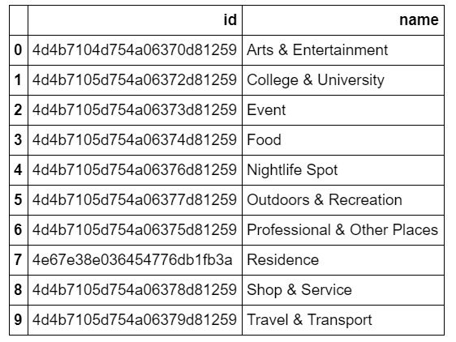
Slide 4
Load & Explore Data
1. Get the list of venues categories in Foursquare
https://api.foursquare.com/v2/venues/categories

Slide 5
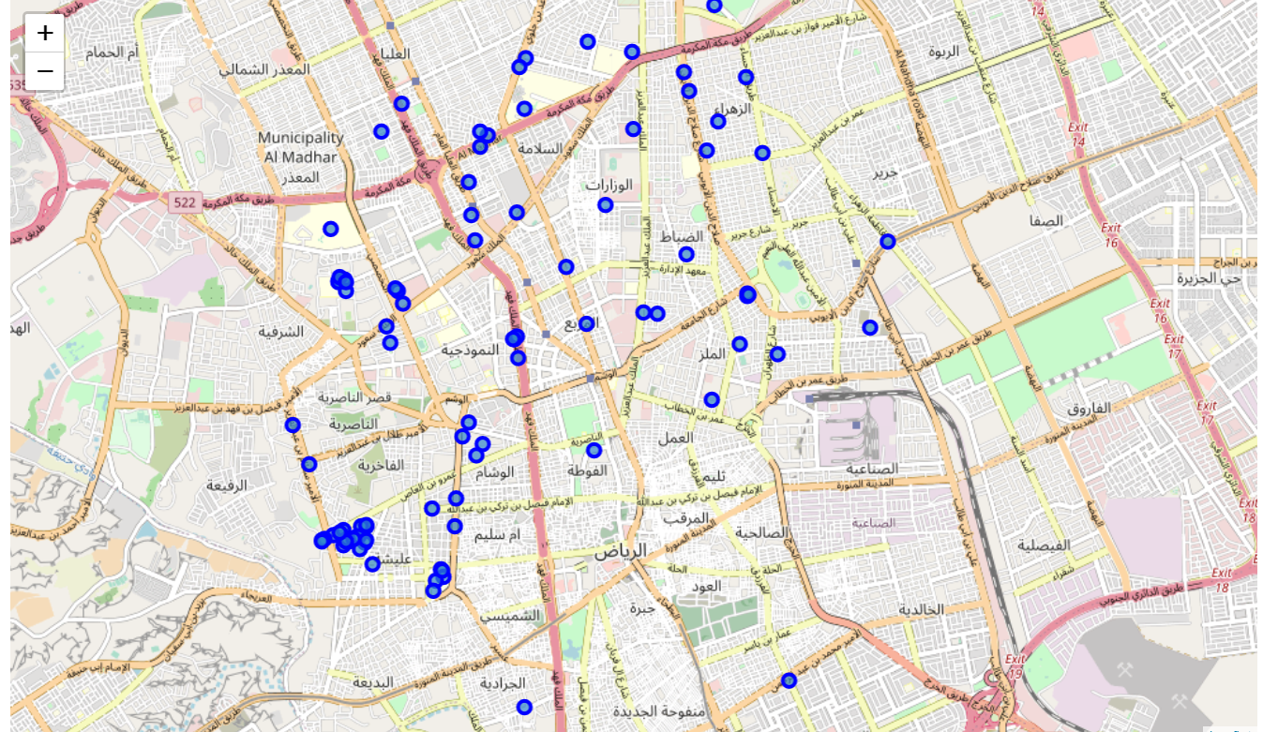
Slide 7
Load & Explore Data
2. Get the colleges in Riyadh with its coordinates

Slide 6
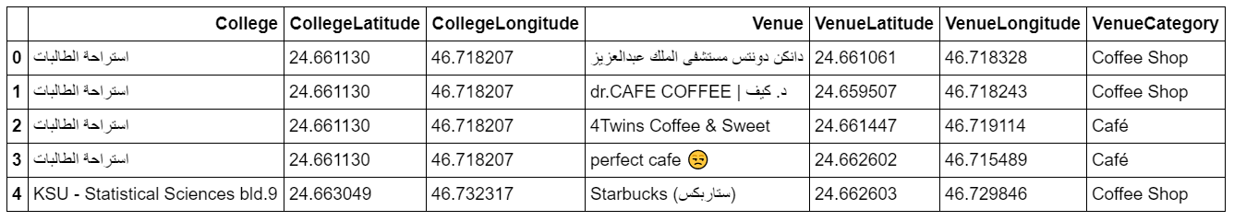
Slide 7
Load & Explore Data
2. Find the competitors (coffee shops) nearby each colleges
The result is 580 rows with 7 attributes

Slide 7
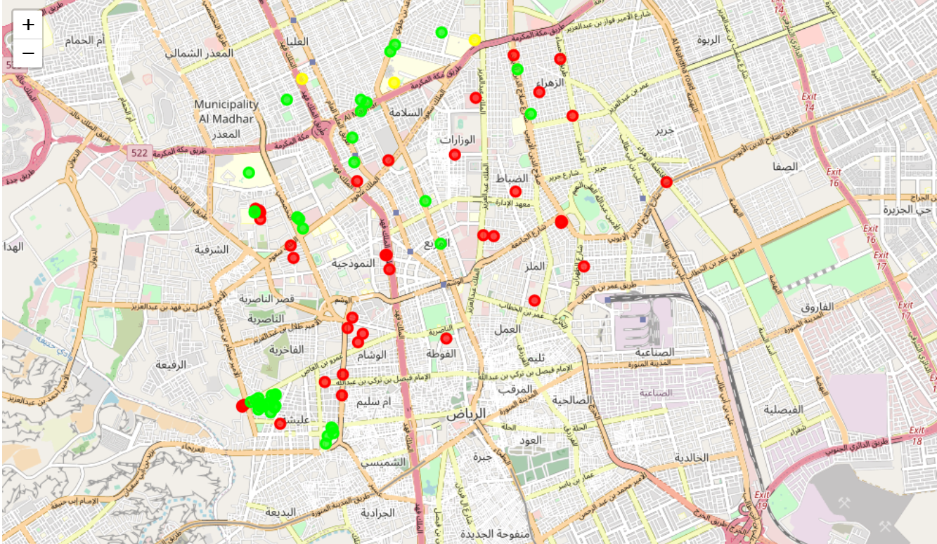
Slide 12
Clustering
Group college by nearby coffee shops
Sort them by coffee shops count
Clean the data frame
Run K-mean to cluster the data into 3 clusters
Finally, visualize the resulted clusters

Slide 8

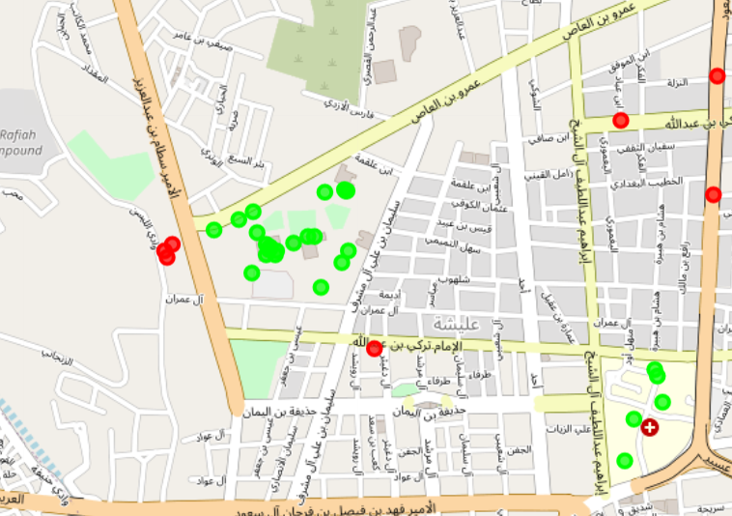

Slide 5
Conclusion
from the result (green spots), south west Riyadh is the best place for new coffee shop as it has lots of coffee-drinker people with less competitors

Slide 9

Slide 15
THANK YOU!
Done by:
Eman ALRefaai

